Slide 1
CSCI 191T
by Inderpal Singh, Joe luna

Slide 2
Cellular Automata

Slide 3

Cellular Automata: Motivation
To better understand simple cellular automata
Employ Cellular automata principles to real world problems
Fire Spreading simulation

Slide 4

Problem Statement
Elementary Automta
Implement an Elementary Using Wolfram codes
The simplest class of one-dimensional cellular automata.
Elementary cellular automata have two possible values for each cell (0 or 1), and rules that depend only on nearest neighbor values.
Forest Fire Automta
Apply concepts from elementary CA to a more advance model
model of a forest implemented as 2d cellular automata
Each cell can have 1 of 3 values (empty, burning, tree)
probabilities
Start Buring
Spread
regrowth

Slide 5


Related Work and Background Material
Stephen Wolfram: New Kind of Science
Ioannis Karafyllidis, Adonios Thanailakis, A model for predicting forest fire spreading using cellular automata

Slide 6
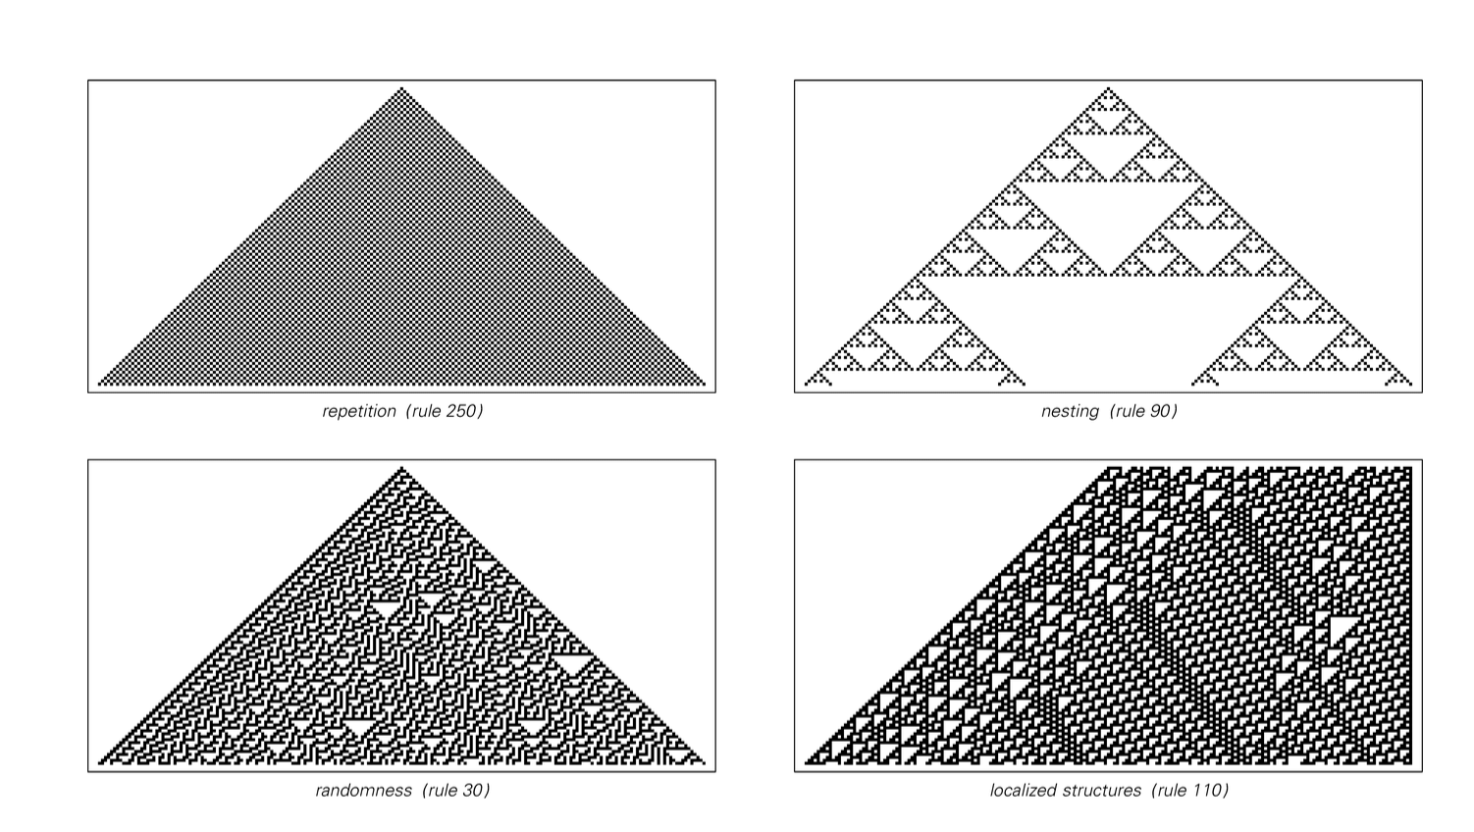

Slide 7
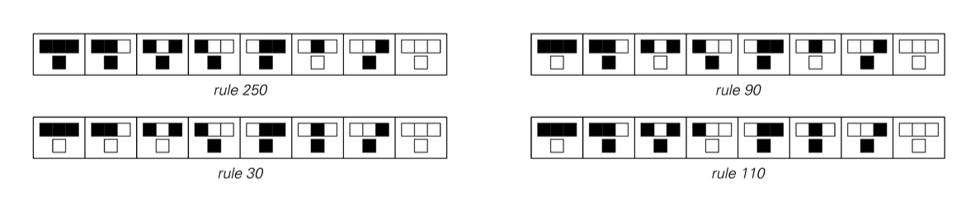
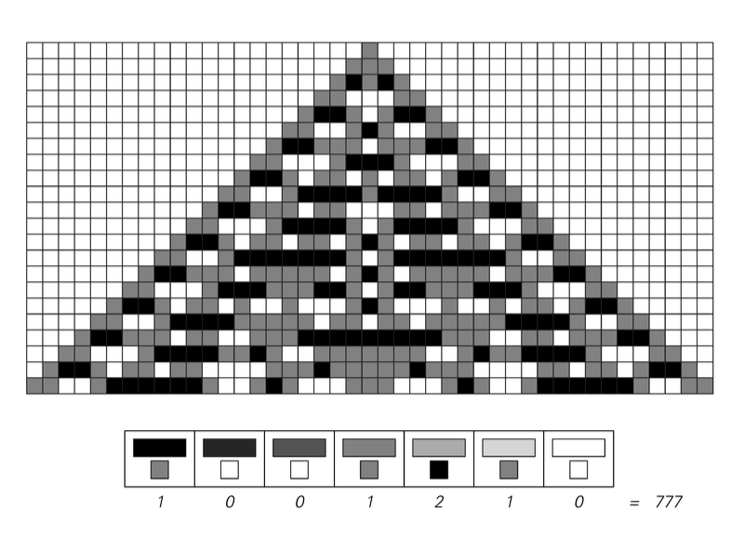
Totalistic Cellular automata with three colors
Only depends on the average of the three colors
Does not necessarily create more complex behaviors
Notes:
There are 256 possible combinations of rules number 0 to 255
Most common is a pattern of single cells or groups of cells that are either stationary or move from one side to the other
some patterns with more bits are more complex than elementary but overall behavior is the same

Slide 8
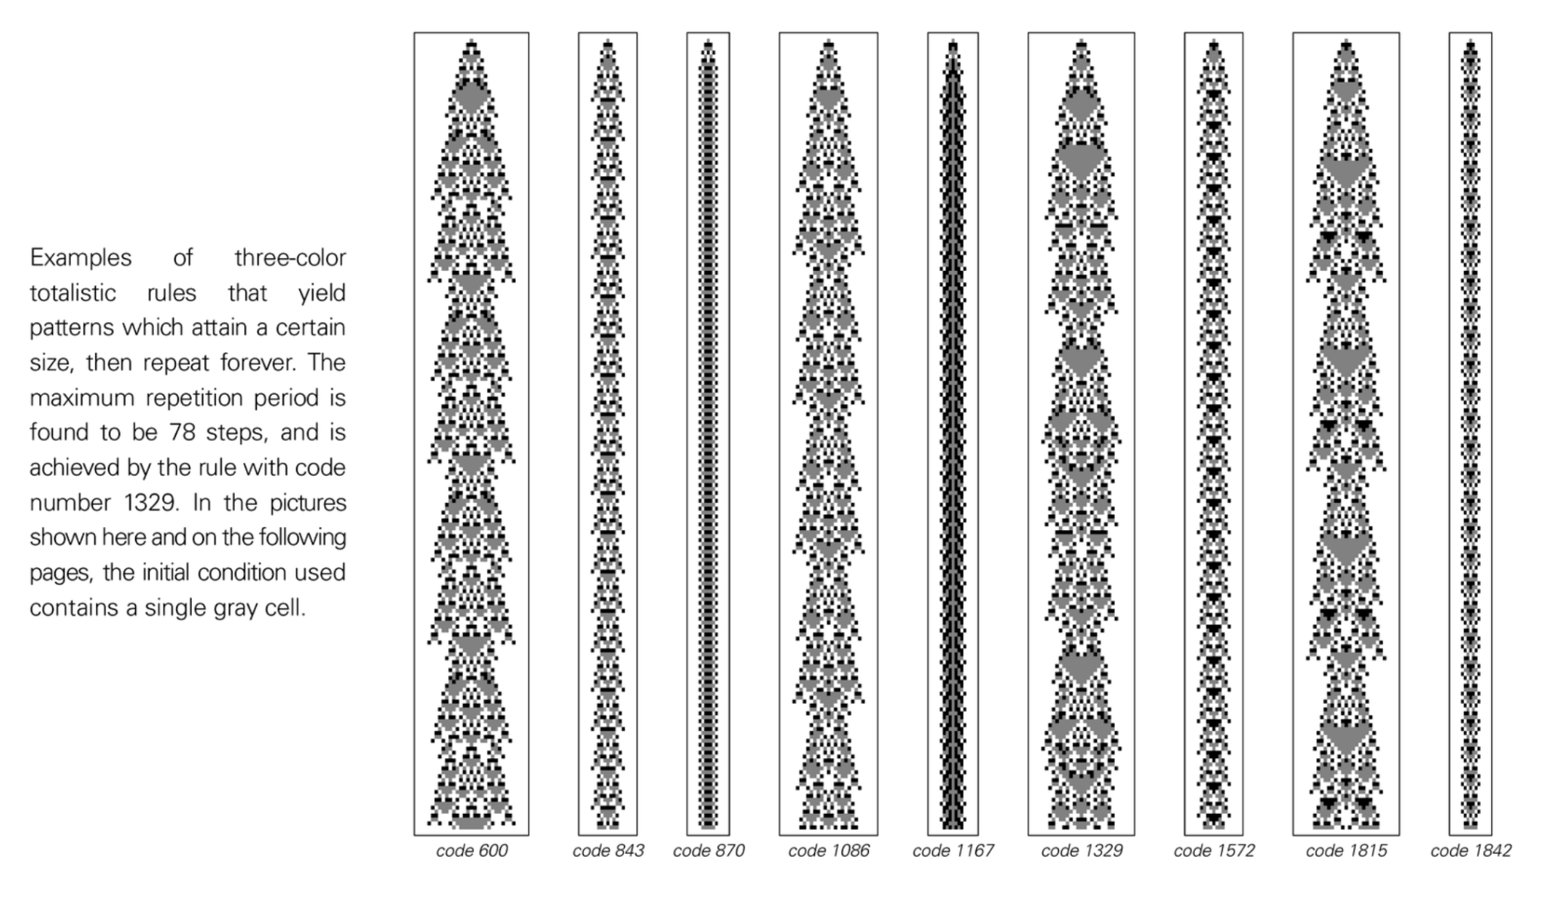

Slide 9
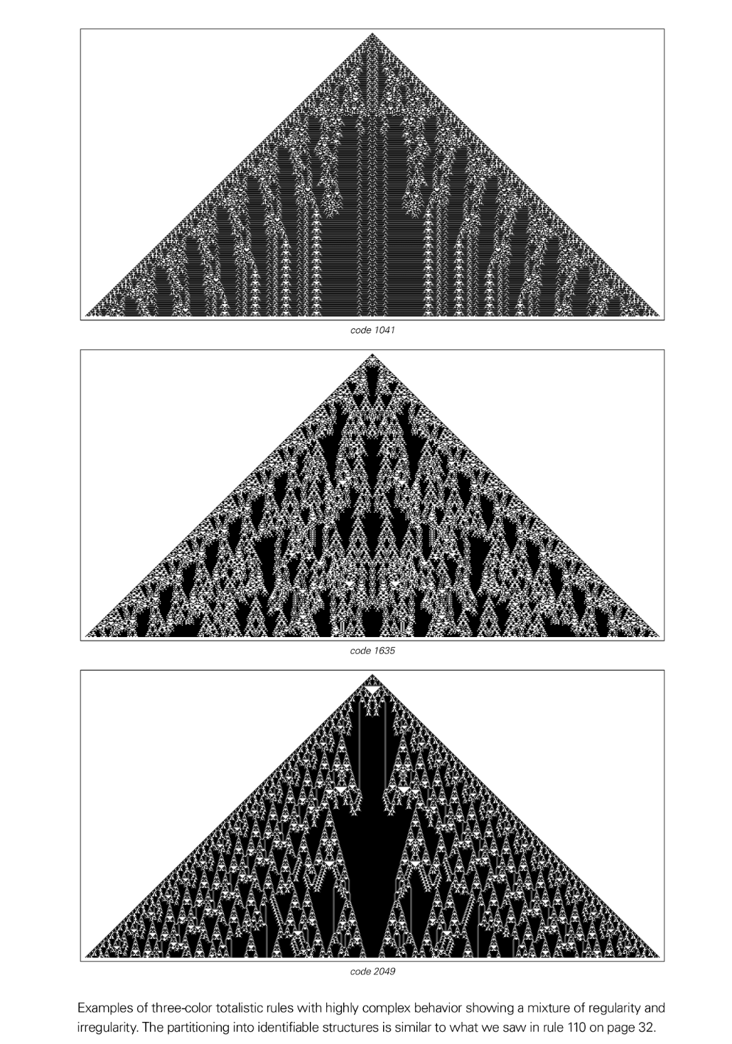
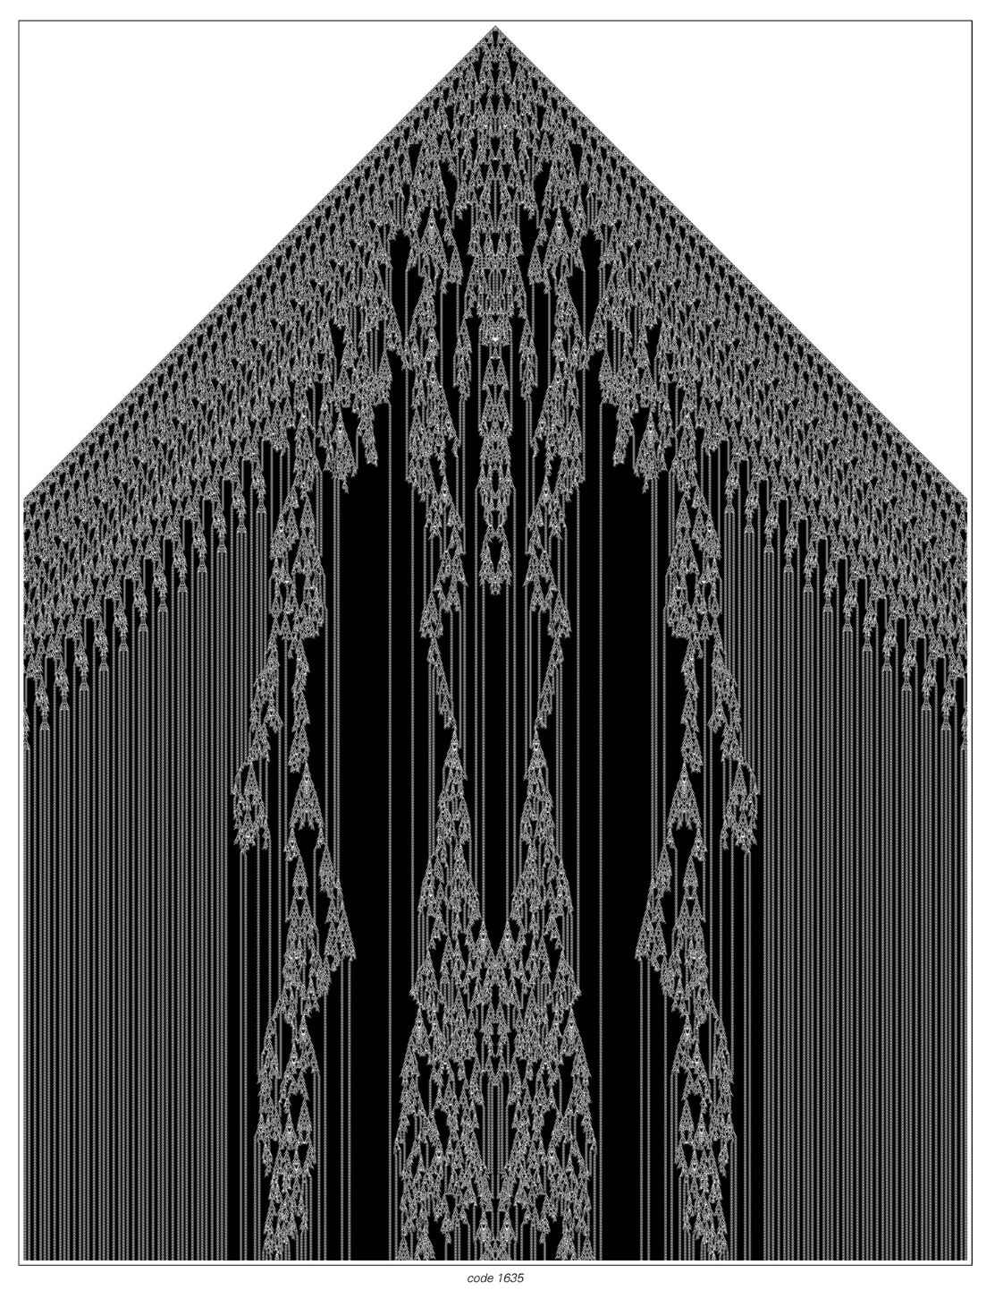

Slide 10
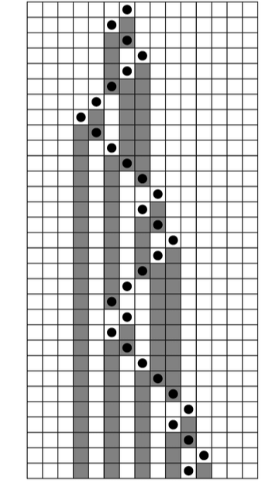
Mobile Automta
Similar to cellular automata except instead of updating all cells in parallel, they have just a single active cell that is updated at each time step
How the cell is updated and moves is dictated by the rule of the mobile automata
65,536 possible rules
Notes:
He extended it so that an active cell could alco update its immediate neighbors at each time step. Most of the new rules were just simple repetitive behavior but, Few new rules displayed some structure.

Slide 11
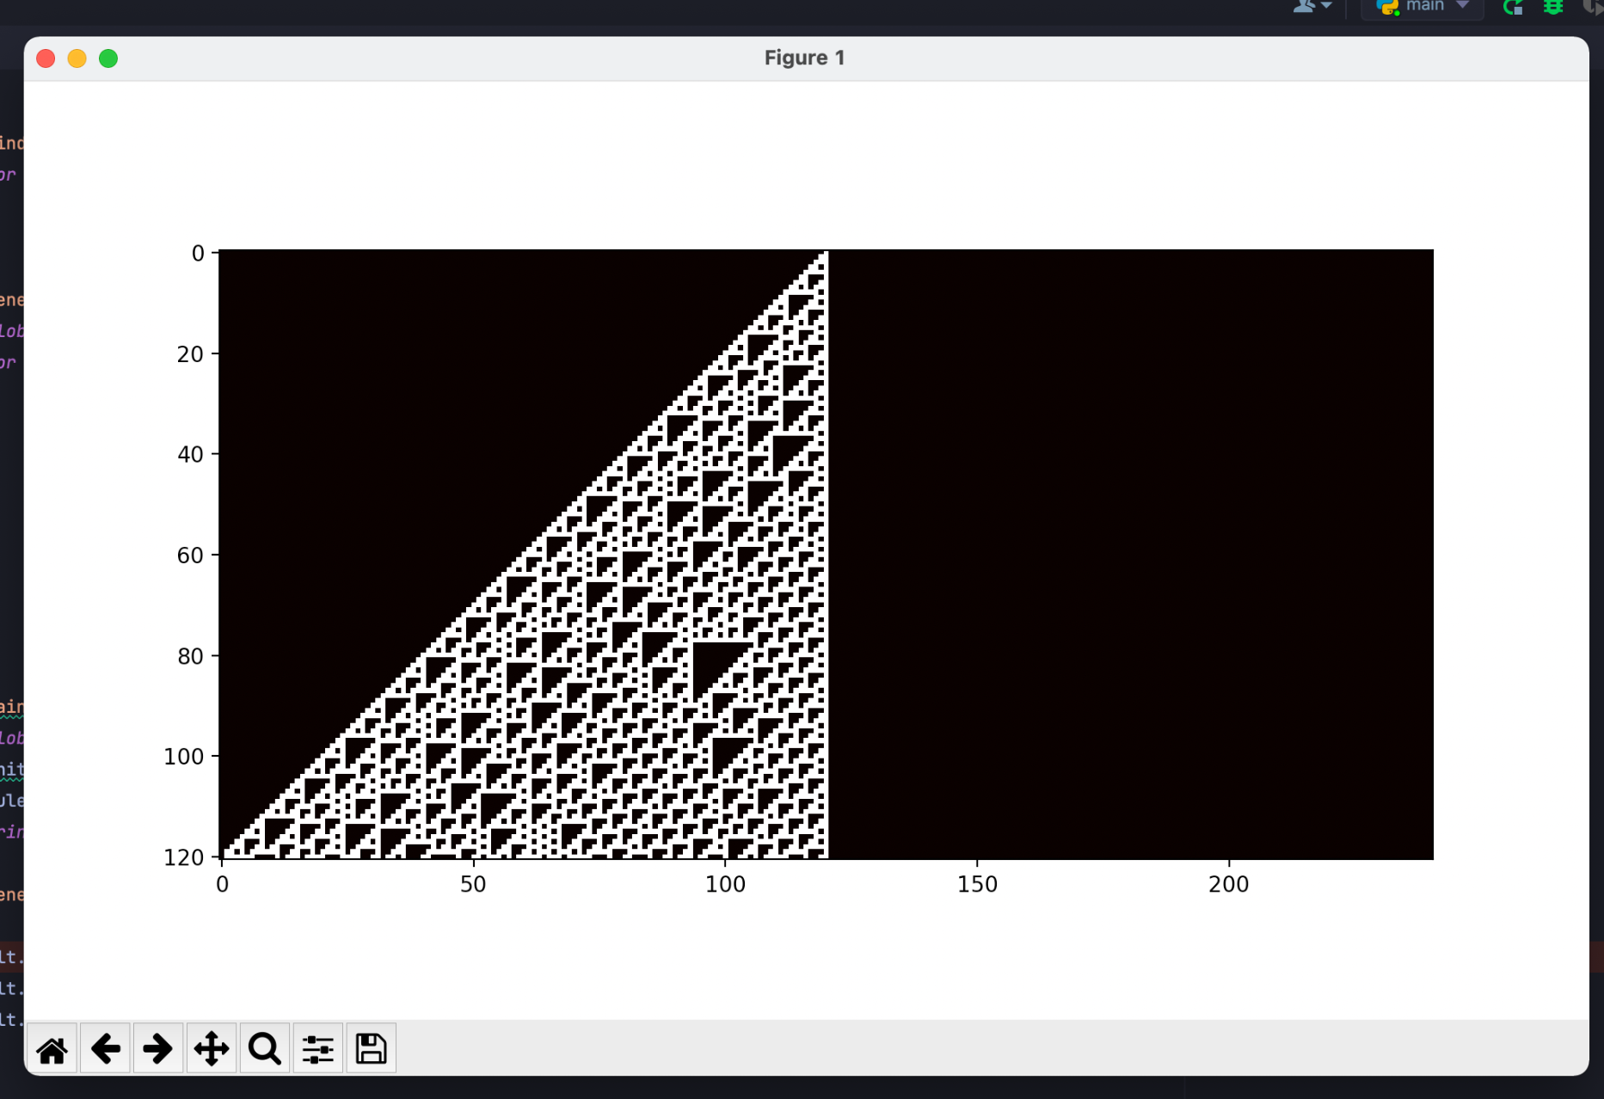
Setup Elementary Automata
Implement Wolframs Elementary automata in Python
Use a dictionary to store different rule sets, ie {“100” : “1” .....}
Use 1 dimensional arrays to store initial array
append next level to previous
Output end result using matplotlib

Slide 12

Approach
Simulate and visualize both CAs using python
CA lend themselves very well to being solved by computers
space and time are discrete
a cell can only be in exactly one state at a time
interactions are only local.
tree burning has chance to catch its neighbor on fire
A tree burning at one corner of the forest does not affect a tree at another corner

Slide 13

Setup Fire Spread CA
Create 2d array and randomly initialize each cell to be occupied or empty
Everytime step
A cell has a chance to randomly catch fire
if cell was burning mark that cell as empty
neighbor of burning cell has probability of catching fire itself
Empty cell has chance to grow tree over time(currently unimplemented)

Slide 14
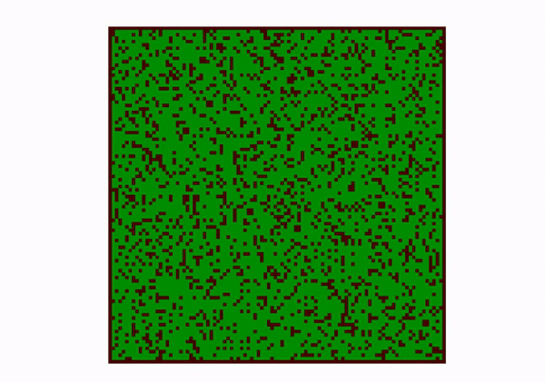
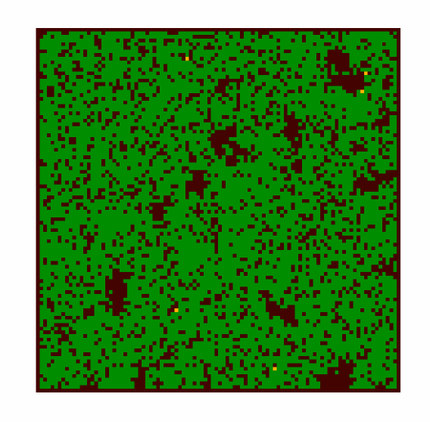
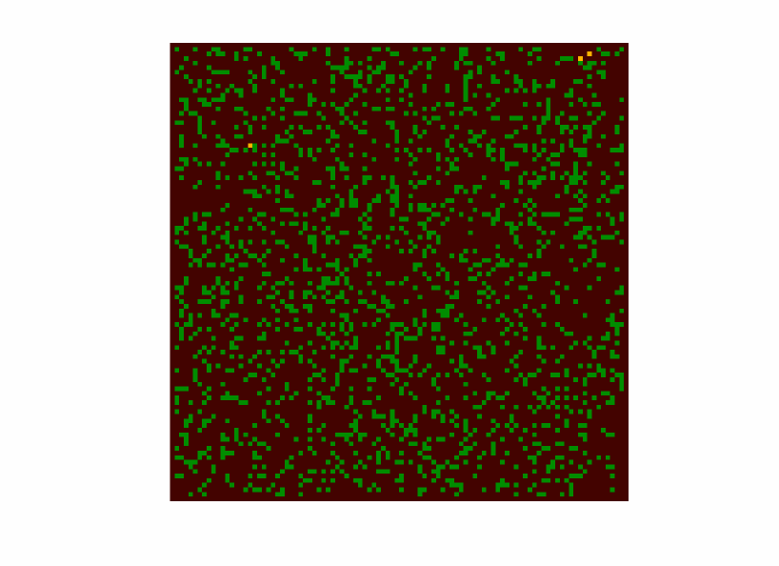

Slide 15

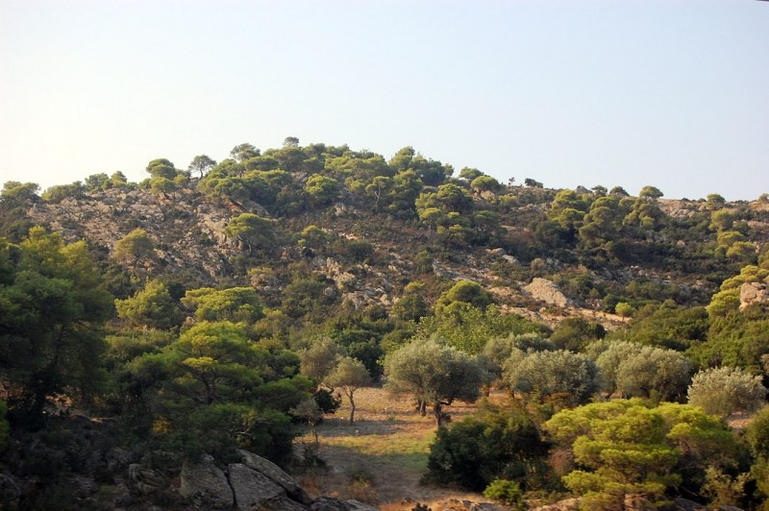
Result
Fire spread is incredibly dependent on parameters
Chance of neighbor burning
Initial forest density
chance for tree to regrow
Random lighting strikes
adaptable to different forest types

Slide 16
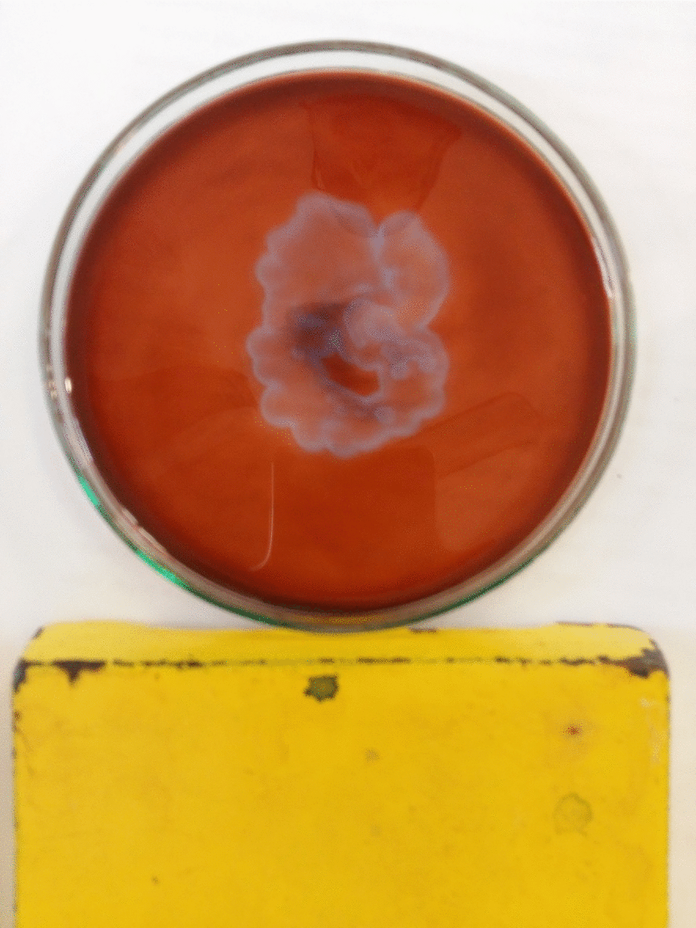
Conclusions
Cellular Automata can exhibit complex emergent behaviors and have potential for simulating advance interconnected systems.
Potential application in chemistry Physics and Biology
Belousov–Zhabotinsky reaction
Future work
Extending model to be more representative of reality
brush and Grasslands
Different burn rates
weather phenomena

Slide 17
Sex as an Algorithm

Slide 18

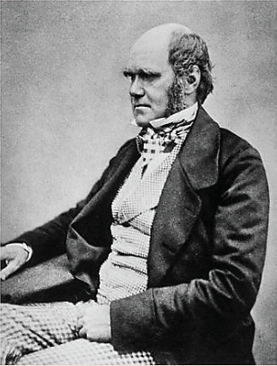
Sex as An Algorithm
Great strides in our understanding of evolution
The Origin of Species
“Unification of Darwinism and Mendelism
Massive hole in our understanding of evolution
Charles Darwin “the whole subject is as yet hidden in darkness”
Sexual reproduction vs. asexual reproduction
Notes:
Ever since Darwin’s release of The Origin of Species in 1859 and his massive contributions to understanding to natural selection, there was one massive problem that Darwin admitted within the very first paragraphs of his book, sex and evolution. He could not grasp how and what was driving this evolution. Nor did he grasp the role sexual reproduction had in evolution if at all. Even today after massive leaps in our understanding of evolution such as discovering alleles and unifying Darwinism and Mendelism into an equation, the role of sexual reproduction in evolution is still shrouded in mystery.

Slide 19

Problem statements
Why is this the case and not the other way around?
What role does sex have in evolution?
What is evolution optimizing exactly if at all?
Are mutations really completely random?
Notes:
Almost every living organism participates in sexual reproduction in order to reproduce, and very few organisms don’t, or are asexual. Why is that the case? What is the role of sex in evolution? What is evolution optimizing if at all? Are mutations really all up to chance? These are the questions the authors from this article are trying to answer or at least try to better understand and their findings are quite extraordinary.

Slide 20

What were their findings?
Sexual reproduciton favors a mixture of alleles where as asexuality favors the best combination
Multiplicative Weights Update Algorithm or a randomized algorithm
Optimizing for the most diverse population instead of the most fit
Connection between evolution and algorithms through game theory, machine learning, and the maximization principle.
Evolution using a machine learning algorithm!?
Notes:
What these authors discovered was that sex behaves almost identically as a game between genes using the Multiplicative Weights Update Algorithm; or as a randomized algorithm where it accepts variants that perform best accross all possible genetic combinations. This algorithm is used within machine learning and with these author’s discovery is incredible. Instead of striving for the best alleles to have the best individuals, evolution under sex excels at creating a diverse gene population. In essence, Genes that perform excellent under many genetic combinations, even ones not quite possible yet. But why? Well, let’s first see about mutations and their possible role.

Slide 21

What about Mutations?!
Mutations may not truly be completely random
As random as a computer random number generator
Algorithmic mutation chance
Sex and mutations?!
Notes:
For a while it was believed that point mutations within genes were mostly random as to where and when it would happen but what the authors propose is that may not be entirely the case. These mutations may as accidental as a random number generator. This makes some mutations almost completely impossible to the theoretical algorithm mutations is playing. But why? We know now mutations are biological processes and these processes are affected by interactions between genes as well. What the authors propose is that the combinations between different encourages specific mutations to occur within that area.In short sex is sending infomration to future mutations or combinaitons what can and cannot be changed through mutation! Communication through the future!

Slide 22
Conclusion
a randomized algorithm selecting for the best overall average alleles instead of the best
sex is playing a generational game with its alleles with a mixed strategy
Mutations may not be totally random.
Sex is optimizing for alleles that best suit the most combinations
Sex is commuticating to the future!!
Notes:
Through algebraic manipulation of the Charles Darwin and Mendel equation, sex is playing a generational coordination game with alleles with its rules being that the multiplicative weights update algorithm. Mutations may not be totally random but statistically decided by the game that sex coordinates. Sex is choosing the best variation of population to discourage mutations to mutate certain traits and encourage mutations in other areas. Meaning sex is communicating to the future! More research must be done but the link between biology, evolution and algorithms seems to grow ever more present and with the help of computer science the mystery of sex may be finally fully unraveled.

Slide 23
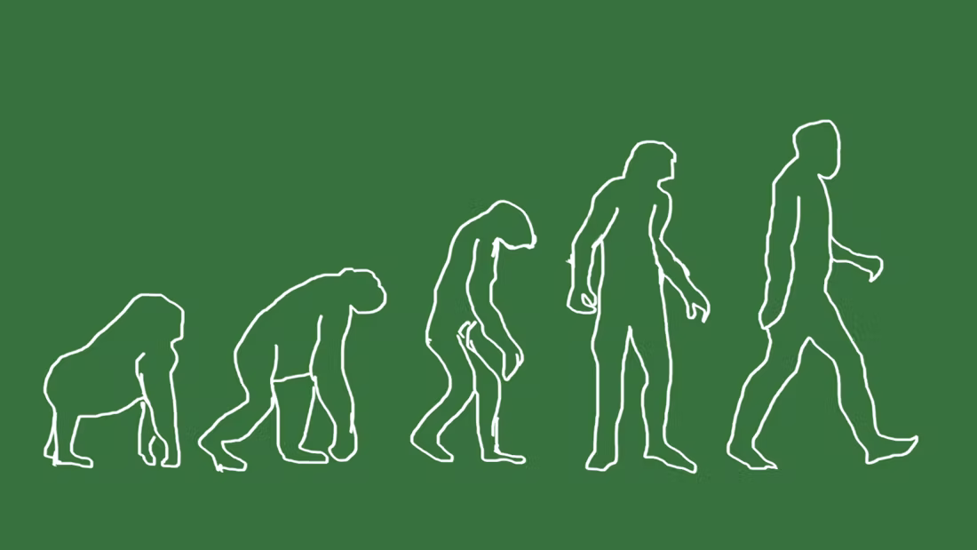
Related Work
Darwin, Charles. THE ORIGIN OF SPECIES (Wordsworth Collection) (Wordsworth Collection). United Kingdom, Wordsworth Editions Limited, 1998.
Livnat, Adi, and Christos Papadimitriou. “Sex as an Algorithm: The Theory of Evolution Under the Lens of Computation.” Communications of the ACM 59, no. 11 (2016): 84–93.
In R. Michod and B. Levin, editors, The Evolution of Sex: An Examination of Current Ideas. Sinauer, Sunderland, 1988
Adi Livnat and Christos Papadimitriou. 2016. Sex as an algorithm: the theory of evolution under the lens of computation. Commun. ACM 59, 11 (November 2016), 84–93. https://doi.org/10.1145/2934662
Reshef Meir and David Parkes. 2015. On Sex, Evolution, and the Multiplicative Weights Update Algorithm. In Proceedings of the 2015 International Conference on Autonomous Agents and Multiagent Systems (AAMAS '15). International Foundation for Autonomous Agents and Multiagent Systems, Richland, SC, 929–937.

Slide 24
Conditioning in Flora and Amoboa

Slide 25


Conditioning in Flora and Amaboa
In the 20th Century Ivan Pavlov Trained Dogs to associate the sound of a buzzer with the presence of food and salivate on command.
He used the salivary secretion as a quantitative measure of the higher nervous activity.
Since then Conditional reflex behaviors have been observed in nearly all vertierites and even some invertebrates
However it raises the question, does an organism need to have a nervous system to exhibit a non voluntary response to some stimulant such as Pavlov's dog did with their buzzer?

Slide 26
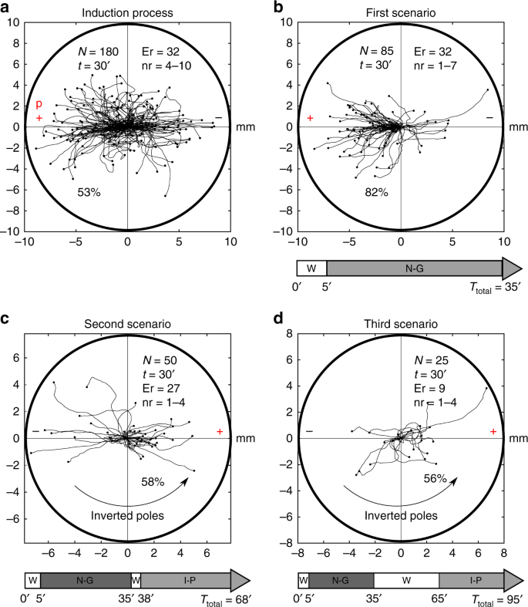
Related material
Ildefonso M. De la Fuente et al, “Evidence of conditioned behavior in amoebae”, Nature (2019)
Gagliano, Monica, et al. "Learning by association in plants.", Nature (2016)

Slide 27
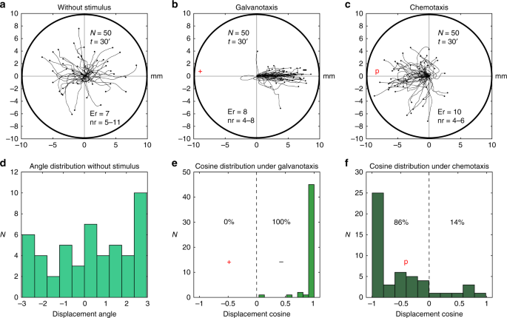
Approach - Amoeba
Amoeba proteus is attracted to a certain peptide, nFMLP, that it uses to track down food
Amoeba proteus also has a behavior where it is attracted to the cathode of an electric field

Slide 28
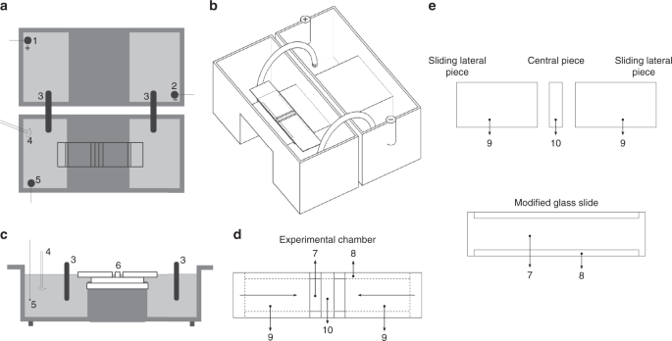
Setup Amoeba
two standard electrophoresis blocks
First one Connected Directly to power supply
Second connected via agar bridge
Monitored movements of cells in central test chamber with camera

Slide 29
Setup Continued
After taking baseline reading the researcher placed the peptide near the anode with the current turned on.
This was the induction step, or geting the amoeba to associate the anode with the potential of food
subsequent trials were conducted after the initial induction process was complete but this time with the pepited removed to see if the amoeba had been properly conditioned

Slide 30
Results and Discussion
After induction cells appeared to show conditioning
Cells moved towards anode instead of cathode
when poles were inverted cells still moved towards anode
Cells showed symptoms conditioning up to 90 minutes after induction

Slide 31

Approach Plants
Since light is necessary for plant growth and survival
ability to modify cell interactions and communications between cells, similarly to neural networks.
Can cells form an associative behavior by being presented with a conditioned stimulus?
Can plants learn?
Notes:
Not too much is known about plant behaviour. We do know that plant need sunlight and water to survive and they will do any means necessary within their abilities to obtain it. We also know that plants have the ability to modify cellular reactions to be able to communicate with other cells in their body making them act like a cell wide neural system. But do plants have the ability to learn? So can plants learn behaviors? Can plants form an associative behavior like an animal might have? This experiment explores these questions and the answers are quite surprising!

Slide 32
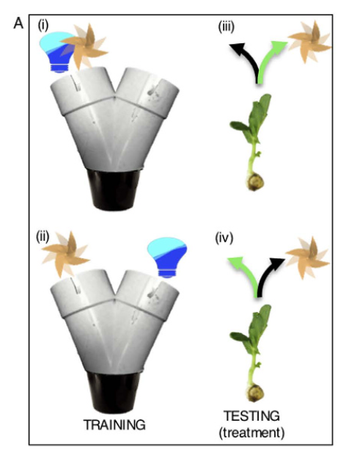
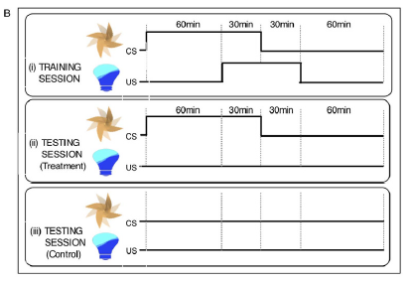
Setup Flora
Experiment 1 (Associative learning)
Each potted pea placed within a Y maze, end of the maze holds either the conditioned stimuli, the unconditioned stimulus, or nothing.
3 groups: one with the conditioned stimulus paired with the unconditioned stimulus,
one with unconditioned stimulus opposite position of the conditioned stimulus
the test group-no conditioned stimulus
Notes:
THere were 2 experiments done. The first experiment was done to see if plants can even form an associative behavior. The way this experiment was conducted was by having two different experiment groups and one control group. One experiment group would receive light alongside with a gust of wind from a fan while the other group would receive gusts of wind with no light. The test group would receive no stimulation. This training was done for 3 days within a Y maze where one end would hold the fan. The results are fascinating!

Slide 33
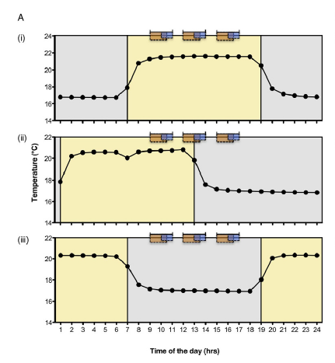
Setup continued
Experiment 2 (Circadian rhythm)
3 groups: light group, light-dark group, dark group
Light group -conditioning during daytimes
Light-dark -conditioning during sunset times
Dark group -conditioning during night time
group 1 conditioning from experiment 1
Notes:
In the second experiment, the peas were conditioned again just like in experiment 1 but now it was changed with the time cycle and temperature. They conditioned the pea seeds just like how the conditioned the first experiment group but the time and temperature would be different. There were three different test groups, the light group, the light dark group and the dark group. The light group was given higher temperatures and conditioning during “daytime hours”, the light dark group would receive conditioning and higher temperatures during midnight up until around high noon. And the dark group would receive their conditioned stimulus during “night time hours”, when the sun would usually go down. What was discovered was amazing!

Slide 34
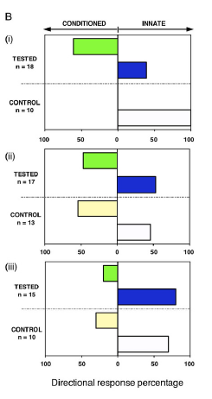
Results Continued
Experiment 1
Light + wind group always went towards the wind, light - wind group always grew away from the wind.
Experiment 2
Dark group almost consistently grew against the tube that contained wind
light-dark group grew within both tubes with light and wind evenly no learned behavior
Light group almost all grew towards the tube with the pipe
Notes:
In experiment 1, What was discovered was that the group 1 always went down the pipe where the wind was, it was trying to predict the light was going to come from. While The second group always went into the opposite pipe the wind was coming from, showing a learned behavior. In the second experiment the results shown that in the light group, they almost always grew within the direction of the wind just like in experiment 1 with the first group. The light dark group however did not do this, instead they splitted where almost half grew down one end of the pipe away from the wind and the other grew into the pipe end with the wind showing some conditioned behavior but a weak one. The dark group’s results were even more dramatic, almost all peas were discovered to not have learned any conditioned behavior.

Slide 35

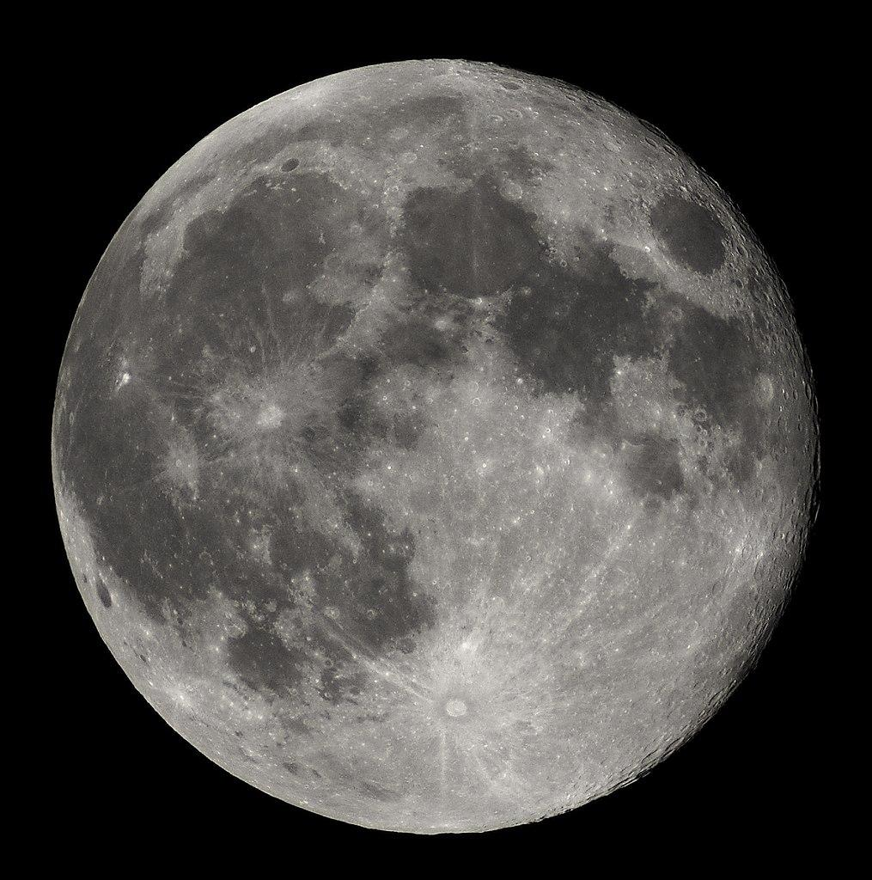
Conclusions
Plants can learn an associative behavior!
Plants learn behaviors better during different times of the day
Plants don’t learn best at “night time”
circadian rhythm
Can plants learn a behavior instead of wind?
Notes:
So what can we get from this experiments? Well we know now that plants can develop an associative behavior! At least with wind as the conditioned stimulus. Plants can learn a behavior only if they are “awake”. Plants can learn an associative behavior if the conditioning stimulus is occurring during “day time”. Plants or at least pea seeds seem to learn an associative behavior with the conditioning is done during day time, when the sun is usually up, if it is during when the sun is down, plants don’t learn, like if you are asleep during lecture. Plants have a circadian rhythm! Plants are smarter than we originally anticipated, and more research must be done!

Slide 36


